Slide 1

.NET Workshop
Joe Guadagno
Senior Director, Technology @ Rocket Mortgage
.NET Foundation Board of Directors

Slide 2
About Joe Guadagno
@jguadagno
JosephGuadagnoNet
JosephGuadagno
Jjg.me/aboutjjg
Jjg.me/github
Jjg.me/youtube
jguadagno@hotmail.com

Slide 3
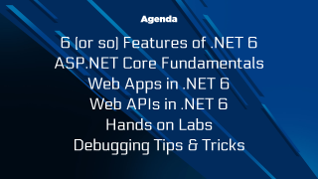
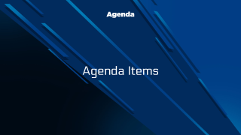
Agenda
6 (or so) Features of .NET 6
ASP.NET Core Fundamentals
Web Apps in .NET 6
Web APIs in .NET 6
Hands on Labs
Debugging Tips & Tricks

Slide 4
6 (or so) Features of .NET 6

Slide 5
Agenda
C# 10
ASP.NET Changes
Maui
Windows Forms Improvements
Performance Improvements
New APIs
Others

Slide 6
Unified Platform

Slide 7
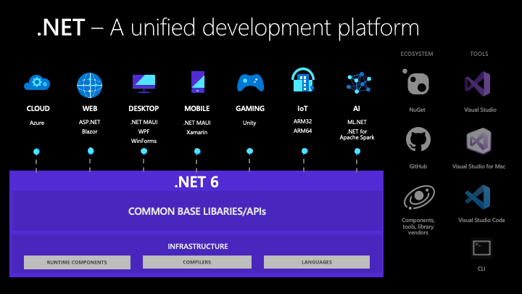
Unified Platform
Notes:
.NET 6 delivers a unified platform, for browser, cloud, desktop, IoT, and mobile apps. The underlying platform has been updated to serve the needs of all app types and to make it easy to re-use code across all your apps. New capabilities and improvements are available to all apps at the same time, so that your code running in the cloud or on a mobile device behaves the same way and has the same benefits.

Slide 8
Targeting .NET 6
<TargetFramework>net6.0</TargetFramework>
Notes:
When you target a framework in an app or library, you're specifying the set of APIs that you'd like to make available to the app or library. You specify the target framework in your project file using a target framework moniker (TFM).
An app or library can also target a specific .NET implementation to gain access to implementation-specific APIs. For example, an app that targets Xamarin.iOS (for example, Xamarin.iOS10) has access to Xamarin-provided iOS API wrappers for iOS 10, or an app that targets Universal Windows Platform (UWP, uap10.0) has access to APIs that compile for devices that run Windows 10.

Slide 9
Other Monikers
net6.0-android
net6.0-ios
net6.0-maccatalyst
net6.0-tvos
net6.0-windows
Notes:
The version-less TFMs are each equivalent to targeting the lowest supported operating system version by .NET 6. You can specify an operating system version if you want to be specific or to get access to newer APIs.
The net6.0 and net6.0-windows TFMs are supported (same as .NET 5). The Android and Apple TFMs are new with .NET 6 and currently in preview. They will be supported with a later .NET 6 update.
There are no compatibility relationships between the OS-specific TFMs. For example, net6.0-ios is not compatible with net6.0-tvos. If you want to share code, you need to do that with source with #if statements or binaries with net6.0 targeted code.

Slide 10
C# 10
Language Improvements

Slide 11
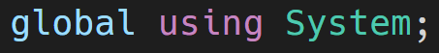
Global Usings in Code
Notes:
using directives simplify how you work with namespaces. C# 10 includes a new global using directive and implicit usings to reduce the number of usings you need to specify at the top of each file.
If the keyword global appears prior to a using directive, that using applies to the entire project:
There is no standard or requirement for where these global statements reside. Most are using globalusings.cs or global.cs

Slide 12
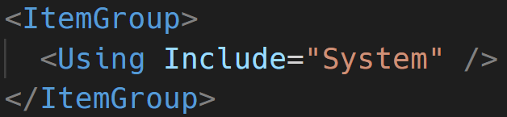
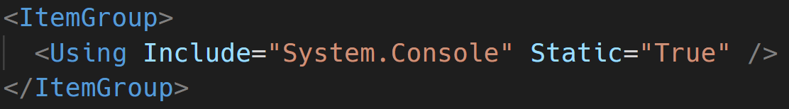
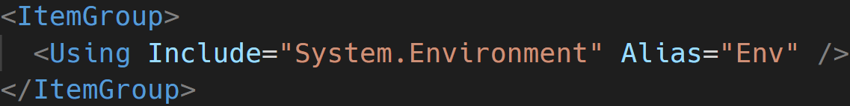
Global Usings in csproj

Slide 13
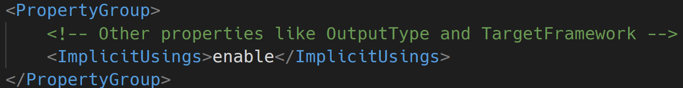
Implicit Usings
Notes:
The Implicit usings feature automatically adds common global using directives for the type of project you are building. To enable implicit usings set the ImplicitUsings property in your .csproj file:
Implicit usings are enabled in the new .NET 6 templates. Read more about the changes to the .NET 6 templates at this blog post.
The specific set of global using directives included depend on the type of application you are building. For example, implicit usings for a console application or a class library are different than those for an ASP.NET application.

Slide 14
Implicit Usings – Project Types
Microsoft.NET.Sdk
Microsoft.NET.Sdk.Web
Microsoft.NET.Sdk.Worker
Microsoft.NET.Sdk.WindowsDesktop (Windows Forms)
Microsoft.NET.Sdk.WindowsDesktop (WPF)
Notes:
Look in obj folder

Slide 15
Implicit Usings – Microsoft.NET.Sdk
System System.Collections.Generic System.IO System.Linq System.Net.Http System.Threading System.Threading.Tasks
http://jjg.me/6_implicit

Slide 16
Implicit Usings – Microsoft.NET.Sdk.Web
System.Net.Http.Json Microsoft.AspNetCore.Builder Microsoft.AspNetCore.Hosting Microsoft.AspNetCore.Http Microsoft.AspNetCore.Routing Microsoft.Extensions.Configuration Microsoft.Extensions.DependencyInjection Microsoft.Extensions.Hosting Microsoft.Extensions.Logging
http://jjg.me/6_implicit

Slide 17
Implicit Usings – Microsoft.NET.Worker
Microsoft.Extensions.Configuration Microsoft.Extensions.DependencyInjection Microsoft.Extensions.Hosting Microsoft.Extensions.Logging
http://jjg.me/6_implicit

Slide 18
Implicit Usings – Microsoft.NET.WindowsDesktop
Windows Forms
Microsoft.NET.Sdk namespaces System.Drawing System.Windows.Forms
WPF
Microsoft.NET.Sdk namespaces Removed System.IO Removed System.Net.Http
http://jjg.me/6_implicit

Slide 19
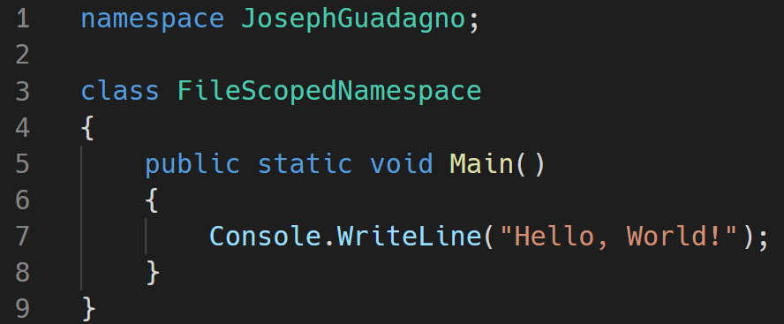
File Scoped Namespaces
Notes:
With this approach, everything you define in the current file belongs to the declared namespace. By removing a nesting level, you make the code a bit cleaner. However, you can't create nested namespaces with this new syntax.

Slide 20
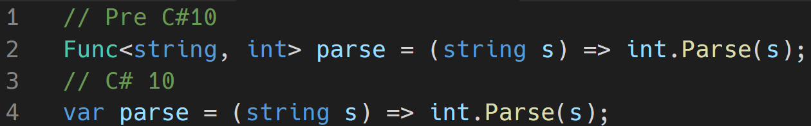
Lambda Improvements
Notes:
Microsoft made several improvements to both the types and the syntax around Lambda’s.
Lambda expressions now sometimes have a “natural” type. This means that the compiler can often infer the type of the lambda expression.
Up until now a lambda expression had to be converted to a delegate or an expression type. For most purposes you’d use one of the overloaded Func<...> or Action<...> delegate types in the BCL:
Natural Return Types
Pre C#10 (Line 2)
Lambda expressions now sometimes have a “natural” type. This means that the compiler can often infer the type of the lambda expression.
Up until now a lambda expression had to be converted to a delegate or an expression type. For most purposes you’d use one of the overloaded Func<...> or Action<...> delegate types in the BCL: Line 2
Starting with C# 10, however, if a lambda does not have such a “target type” we will try to compute one for you:
C#10 (Line 4)
You can hover over var parse in your favorite editor and see that the type is still Func<string, int>. In general, the compiler will use an available Func or Action delegate, if a suitable one exists. Otherwise, it will synthesize a delegate type (for example, when you have ref parameters or have a large number of parameters).

Slide 21
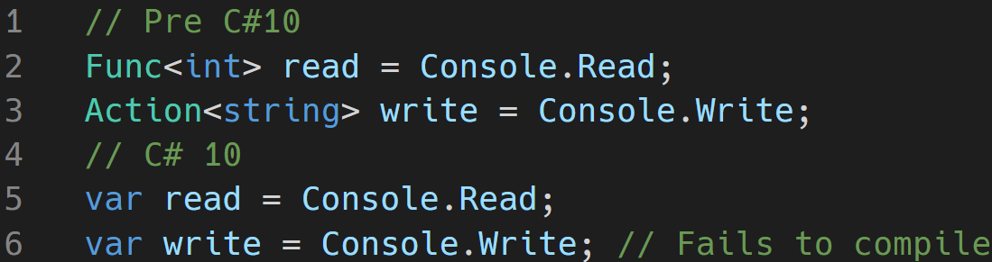
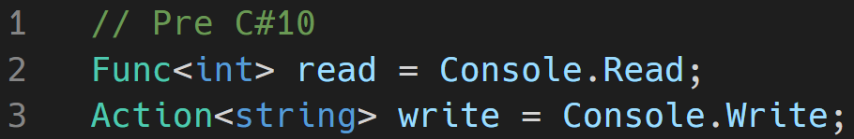
Lambda Improvements
Notes:
Natural Types for Methods
Method groups (that is, method names without argument lists) now also sometimes have a natural type. You have always been able to convert a method group to a compatible delegate type:
<CLICK>
Now, if the method group has just one overload it will have a natural type:

Slide 22
Other Improvements
Improvements to struct
Interpolated string improvements
More at:
https://jjg.me/6_c10
Notes:
Structs
Starting in C# 10, you can include your own parameterless struct constructors. If you don’t supply one, the implicit parameterless constructor will be supplied to set all fields to their default. Parameterless constructors you create in structs must be public and cannot be partial:
record structs similar to that of the record class
Interpolated String Improvements
Memory is handled better by not using String.Format for each item.
Const interpolated strings
String handlers to Overwrite how string processing is done

Slide 23
ASP.NET
What’s New!

Slide 24
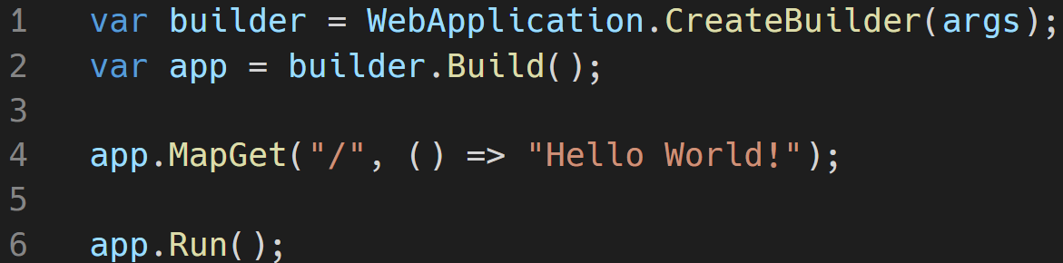
Minimal APIs
http://jjg.me/6_minapi
Notes:
Can remove line #2
Still have access to configuration, ports, environment, DI, and more
Intended for experience developers. Example use cases: file server, reading status updates
Can me mixed and matched with MVC

Slide 25
Other Improvements
SignalR Improvements
Razor Page Improvements
Hot Reload
HTTP/3 Support
Improved SPA
Web App Template Improvements
https://jjg.me/6_aspnetcore
Notes:
SignalR
SignalR uses the new Microsoft.AspNetCore.Http.Features.IHttpActivityFeature.Activity to add an http.long_running tag to the request activity. IHttpActivityFeature.Activity is used by APM services like Azure Monitor Application Insights to filter SignalR requests from creating long running request alerts.
Perf Improvements
Allocate HubCallerClients once per connection instead of every hub method call.
Avoid closure allocation in SignalR DefaultHubDispatcher.Invoke. State is passed to a local static function via parameters to avoid a closure allocation. For more information, see this GitHub pull request.
Allocate a single StreamItemMessage per stream instead of per stream item in server-to-client streaming. For more information, see this GitHub pull request.
Razor
Razor compiler uses source generators, no longer produces a separate views assembly
Hot Reload enables you to skip rebuilding and restarting your app to view a new change — while your app is running — supported in Visual Studio 2022 and from the .NET CLI, for C# and Visual Basic.
HTTP/3 has been added so that ASP.NET Core, HttpClient, and gRPC can all interact with HTTP/3 clients and servers.
Single-page apps built with ASP.NET Core now use a more flexible pattern that can be used with Angular, React, and other popular frontend JavaScript frameworks.
Web Templates Angular updated to v12

Slide 26
Windows Forms
Improvements

Slide 27
Accessibility Improvements
CheckedListBox
LinkedLabel
Panel
ScrollBar
TabControl
TrackBar
Notes:
In this release, Microsoft added UI Automation Provider (UIA providers) for CheckedListBox, LinkLabel, Panel, ScrollBar, TabControl and TrackBar that enable tools like Narrator, and test automation to interact with the elements of an application.
A Microsoft UI Automation provider is a software object that exposes an element of an application's UI so that accessibility client applications can retrieve information about the element and invoke its functionality. In general, each control or other distinct element in a UI has a provider.

Slide 28
Default Font

Slide 29
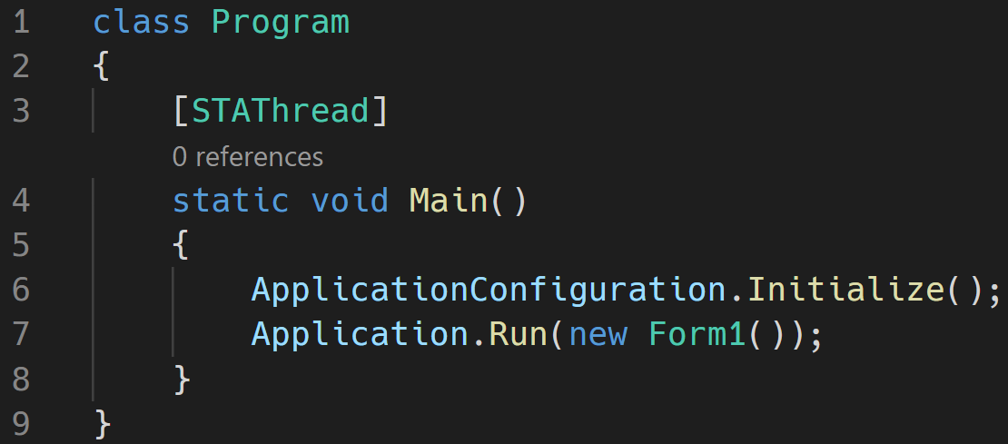
Minimal App
Notes:
As part of the .NET 6 release, most of the templates have been updated to make them more modern and minimal, including with Windows Forms. We decided to keep the Windows Forms template a bit more traditional, in part because of the need for the [STAThread] attribute to apply to the application entrypoint. However, there is more a play than immediately meets the eye.
ApplicationConfiguration.Initialize() is a source generated API that behind the scenes emits the following calls:
Application.EnableVisualStyles();
Application.SetCompatibleTextRenderingDefault(false);
Application.SetDefaultFont(new Font(...));
Application.SetHighDpiMode(HighDpiMode.SystemAware);

Slide 30
Other Window Forms Updates
Template Updates
More Runtime Designers
Single-File Apps
https://jjg.me/6_winforms
Notes:
Template updates
Windows Forms templates for C# have been updated to support the new application bootstrap, global using directives, file-scoped namespaces, and nullable reference types.
More runtime designers
Now you can build a general-purpose designer (for example, a report designer) since .NET 6 has all the missing pieces for designers and designer-related infrastructure. For more information, see this blog post.
Single-file Apps
In .NET 6, in-memory single file apps have been enabled for Windows and macOS. In .NET 5, this deployment type was limited to Linux. You can now publish a single-file binary that is both deployed and launched as a single file, for all supported OSes. Single files apps no longer extract any core runtime assemblies to temporary directories.

Slide 31
Performance Improvements

Slide 32
File IO Improvements
Method | Runtime | Mean | Ratio | Allocated
Write100MBAsync | .NET 5.0 | 1,308.2 ms | 1.00 | 3,809 KB
Write100MBAsync | .NET 6.0 | 306.8 ms | 0.24 | 3 KB
https://jjg.me/6_FileIO
Notes:
Changes made to File.IO include FileStream
On Windows, changes were made to FileStream.Seek and FileStream.Position which increased perf from 10-100%
On Unix,changes were made to SeekForward to now use lseek, which increased perf 25%
Reading jumped 3%
<CLICK>
Table
Writing out to 100mb file
On Windows with an SSD drive, they observed a 4x speedup and more than a 1200x allocation drop:

Slide 33
System.Text.Json Source Generators
Method | Mean | StdDev | Ratio
Serializer | 243.1 ns | 9.54 ns | 1.00
SrcGenSerializer | 149.3 ns | 1.91 ns | 0.62
Notes:
Microsoft added a source generator for System.Text.Json that avoids the need for reflection and code generation at runtime, and that enables generating optimal serialization code at build time. Serializers are typically written with very conservative techniques because they have to be. However, if you read your own serialization source code (that uses a serializer), you can see what the obvious choices should be that can make a serializer a lot more optimal in your specific case. That’s exactly what this new source generator does.
In addition to increasing performance and reducing memory, the source generator produces code that is optimal for assembly trimming. That can help with producing smaller apps.
<CLICK>
Serializing POCOs is a very common scenario. Using the new source generator, we observe that serialization is ~1.6x faster with our benchmark.

Slide 34
New APIs
Some JSON and Library APIs

Slide 35
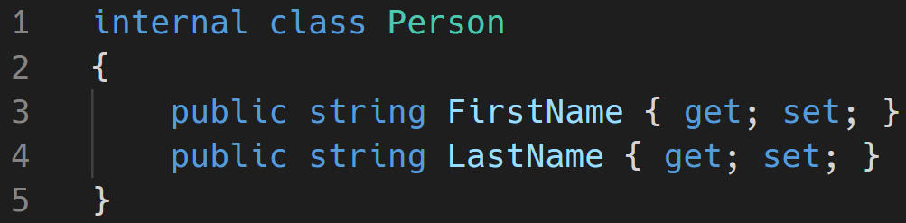
JSON APIs - Serialization
Notes:
In .NET 6.0, we are shipping a new C# source generator to help improve the performance of applications that use System.Text.Json.
With the introduction of the System.Text.Json source generator, we now have a few models for JSON serialization in .NET to choose from, using JsonSerializer. There is the existing model which is backed by runtime reflection, and two new compile-time source generation modes; where the generator generates optimized serialization logic, a static data access model, or both. In both source-generation scenarios, the generated artifacts are passed directly to JsonSerializer as a performance optimization.

Slide 36
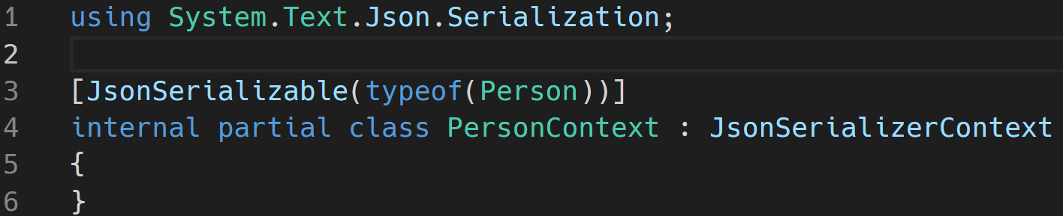
JSON APIs - Serialization
Notes:
We specify the source generator as follows

Slide 37
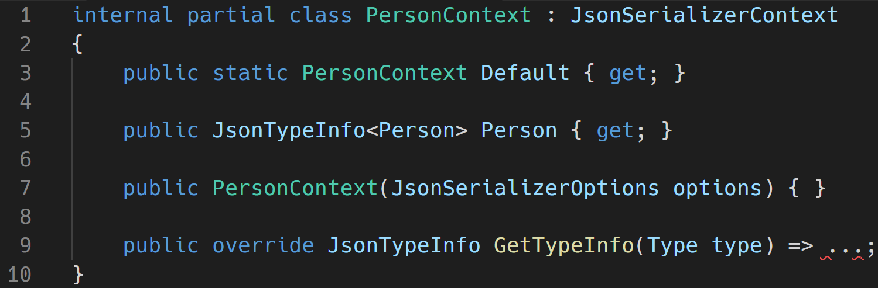
JSON APIs - Serialization
Notes:
As part of the build, the source generator will augment the MyJsonContext partial class with the following shape

Slide 38
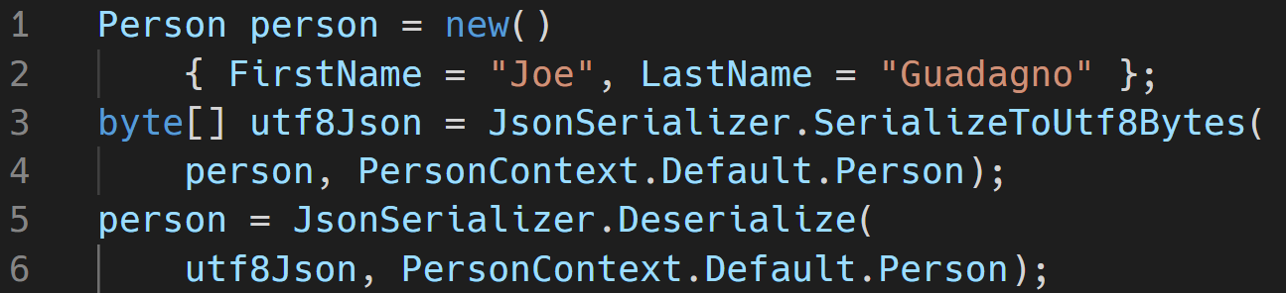
JSON APIs - Serialization
https://jjg.me/6_json
Notes:
The generated source code can be integrated into the compiling application by passing it directly to new overloads on JsonSerializer:
JsonSerializer is a tool that serializes .NET objects into JSON strings, and deserializes .NET objects from JSON strings. To process a type, the serializer needs information about how to access its members. When serializing, the serializer needs access to the object’s property and field getters. Similarly, when deserializing, the serializer needs access to a constructor to instantiate the type, and also to setters for the object’s properties and fields.
This is all done at compile time so not reflection is need which
Increased serialization throughput
Reduced start-up time
Reduced private memory usage
Removed runtime use of System.Reflection and System.Reflection.Emit
Trim-compatible serialization which reduces application size
While serializing this Person class with a Source Generator, there was around 1.6x performance increase

Slide 39
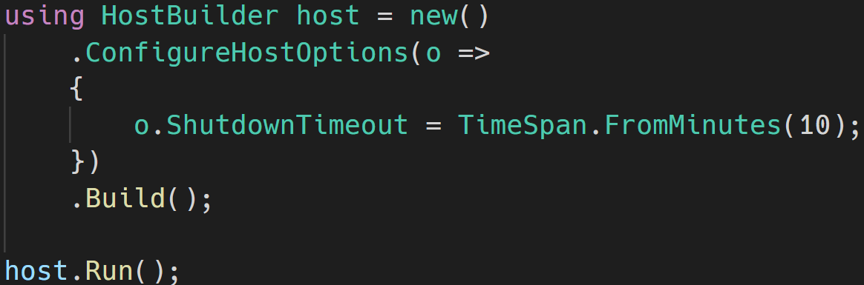
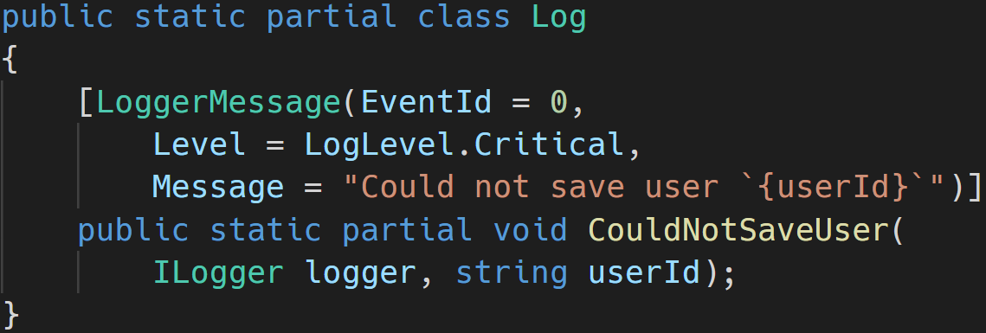
New APIs for the Web
WebSocket Compression (Community Contribution)
Socks Proxy Support (Community Contribution)
Microsoft.Extensions.Hosting - ConfigureHostOptions API
Microsoft.Extensions.Logging - compile time source generator
Notes:
Microsoft.Extensions.Hosting — ConfigureHostOptions API
We added a new ConfigureHostOptions API on IHostBuilder to make application setup simpler (for example, configuring the shutdown timeout):
.NET 6 introduces the LoggerMessageAttribute type. This attribute is part of the Microsoft.Extensions.Logging namespace, and when used, it source-generates performant logging APIs. The source-generation logging support is designed to deliver a highly usable and highly performant logging solution for modern .NET applications. The auto-generated source code relies on the ILogger interface in conjunction with LoggerMessage.Define functionality.
The source generator is triggered when the LoggerMessageAttribute is used on partial logging methods. When triggered, it is either able to autogenerate the implementation of the partial methods it’s decorating or produce compile-time diagnostics with hints about proper usage. The compile-time logging solution is typically considerably faster at runtime than existing logging approaches. It achieves this by eliminating boxing, temporary allocations, and copies to the maximum extent possible.

Slide 40
System.Linq
Enumerable support for Index and Range parameters
TryGetNonEnumeratedCount
DistinctBy/UnionBy/IntersectBy/ExceptBy
MaxBy/MinBy
Chunk (Community Contribution)
FirstOrDefault/LastOrDefault/SingleOrDefault (Community Contribution) overloads taking default parameters
Zip (Community Contribution)
PriorityQueue (Community Contribution)
Notes:
The Enumerable.ElementAt method now accepts indices from the end of the enumerable, as you can see in the following example.
The TryGetNonEnumeratedCount method attempts to obtain the count of the source enumerable without forcing an enumeration. This approach can be useful in scenarios where it is useful to preallocate buffers ahead of enumeration, as you can see in the following example.
DistinctBy.. MinBy New variants have been added to the set operations that allow specifying equality using key selector functions, as you can see in the following example.
Chunk can be used to chunk a source enumerable into slices of a fixed size
The Zip method now supports combining three enumerables
PriorityQueue<TElement, TPriority> (System.Collections.Generic) is a new collection that enables adding new items with a value and a priority. On dequeue the PriorityQueue returns the element with the lowest priority value. You can think of this new collection as similar to Queue<T> but that each enqueued element has a priority value that affects the behavior of dequeue.

Slide 41
Other Enhancements
CLI changes, and Roslyn Analyzers

Slide 42
CLI Changes – Optional Workloads
dotnet workload restore
dotnet workload install
dotnet workload list
dotnet workload update
Notes:
dotnet workload restore — installs the workloads required by a given project.
dotnet workload install — installs a named workload.
dotnet workload list — lists the workloads you have installed.
dotnet workload update — updates all installed workloads to the newest available version.

Slide 43
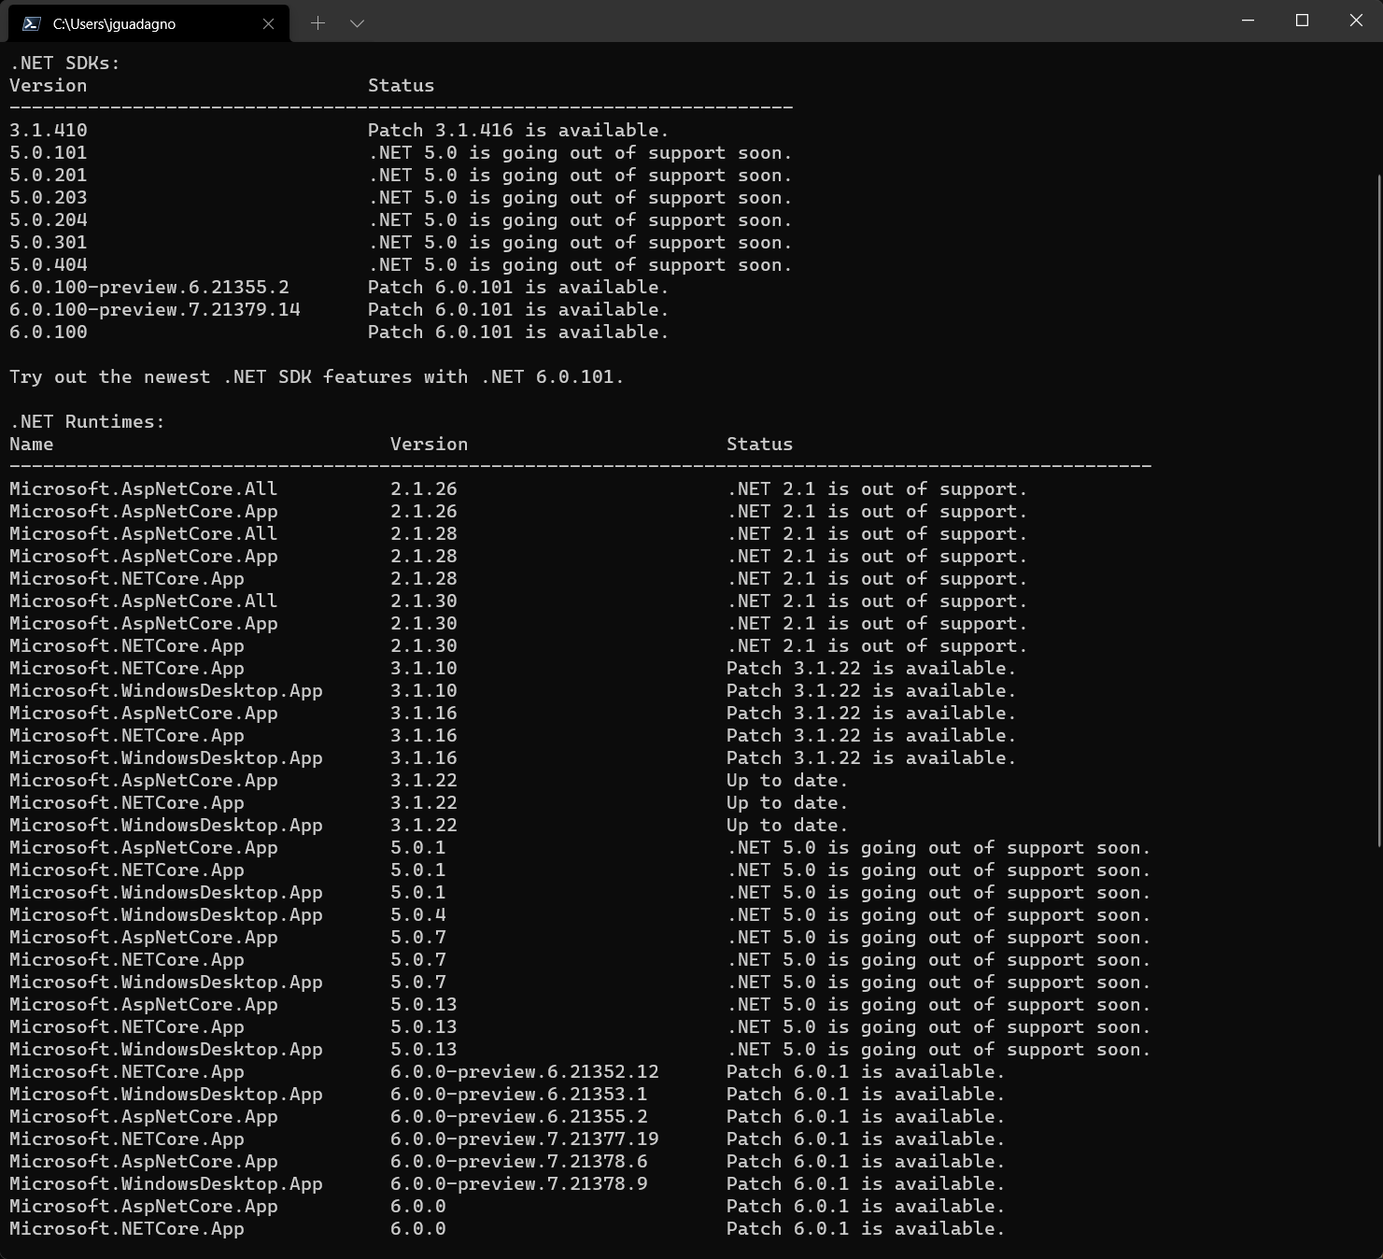
SDK Version Checking
dotnet sdk check
Notes:
dotnet new
You can now search NuGet.org for new templates with dotnet new --search.
Other improvements to template installation include support for the --interactive switch to support authorization credentials for private NuGet feeds.
Once CLI templates are installed, you can check if updates are available via --update-check and --update-apply.

Slide 44
Other CLI Changes
dotnet new
--search
--interactive
--update-check
--update-apply
Notes:
You can now search NuGet.org for new templates with dotnet new --search.
Other improvements to template installation include support for the --interactive switch to support authorization credentials for private NuGet feeds.
Once CLI templates are installed, you can check if updates are available via --update-check and --update-apply.

Slide 45
Roslyn Analyzers
16 Analyzers were added
6 were from the community
https://jjg.me/6_roslyn

Slide 46
.NET Support Policy
Release Lifecycle and Cadence

Slide 47
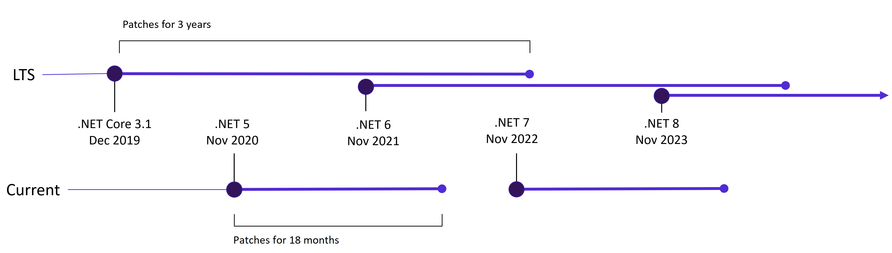
.NET Release Cadence
https://jjg.me/6_support

Slide 48
.NET and .NET Core Release Lifecycle
Version | Original Release Date | Latest Patch | Patch Release Date | Support Level | End of Support
.NET 6 | November 8, 2021 | 6.0.1 | December 14, 2021 | LTS | November 8, 2024
.NET 5 | November 10, 2020 | 5.0.13 | December 14, 2021 | Current | May 8, 2022
.NET Core 3.1 | December 3, 2019 | 3.1.22 | December 14, 2021 | LTS | December 3, 2022
https://jjg.me/6_support
Notes:
This means .NET Core 3.0 and earlier is out of support.

Slide 49
ASP.NET Core Fundamentals

Slide 50
ASP.NET Core Fundamentals
Program.cs
Dependency Injection
Application Configuration
Logging
Middleware
Host
Environments
Routing
Error Handling
Notes:
Reference for this section: ASP.NET Core fundamentals overview | Microsoft Learn

Slide 51
Program.cs
The “heart” of your application
Notes:
Reference for this section: https://learn.microsoft.com/en-us/aspnet/core/fundamentals/?view=aspnetcore-7.0

Slide 52
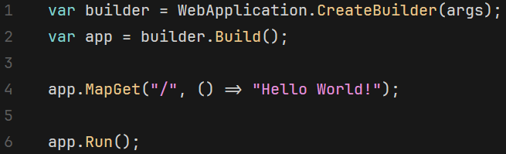
Program.cs
Create
Build
Run
Notes:
Startup.cs is gone.
No main method
You now configure/build your application in Program.cs

Slide 53
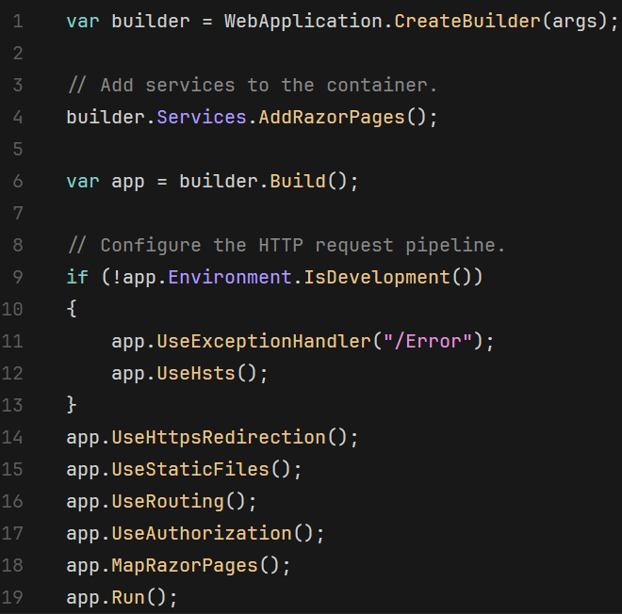
Program.cs – ASP.NET Core Web Application
Create
Services
Build
Middleware
Run
Notes:
We have the Create, Build, and Run…
But now we have Services and Middleware
We register the services required for our application. In this example, we are adding the Razor Pages
We then configure the Middleware. Middleware sets up what happens when a request is made. More on that in a few slides.
Before, we talk about Services, we need to talk about Dependency Injection.

Slide 54
Dependency Injection
Dependency injection is a design pattern that allows us to decouple the creation of objects from their usage, making our code more flexible and maintainable.
Notes:
ASP.NET Core supports the dependency injection (DI) software design pattern, which is a technique for achieving Inversion of Control (IoC) between classes and their dependencies.

Slide 55
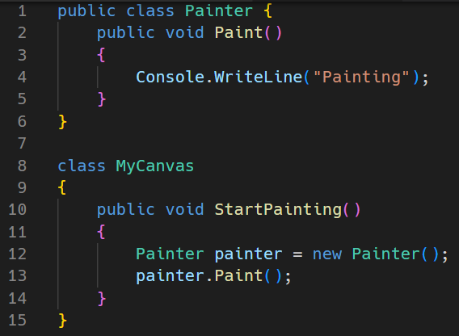
Dependency Injection
Painting
Notes:
A dependency is an object that another object depends on. Examine the following Painter class with a Paint method that other classes depend on:

Slide 56
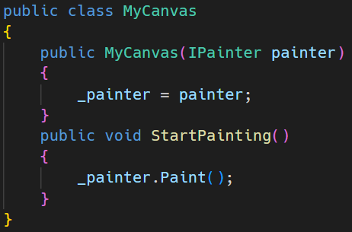
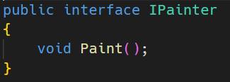
IPainter

Slide 57
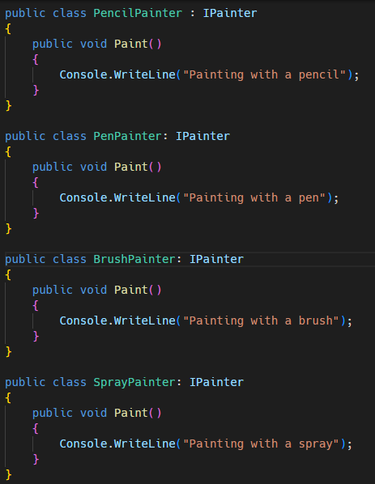
Painters

Slide 58
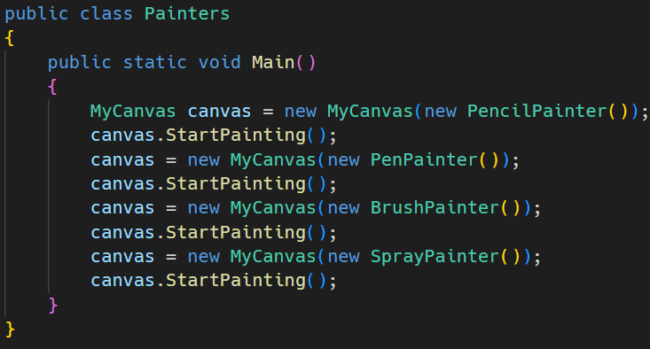

Your Canvas
Pencil
Pen
Brush
Spray

Slide 59
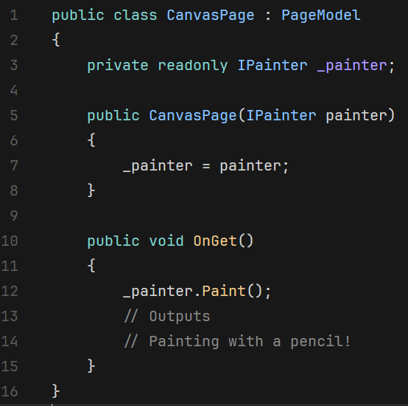
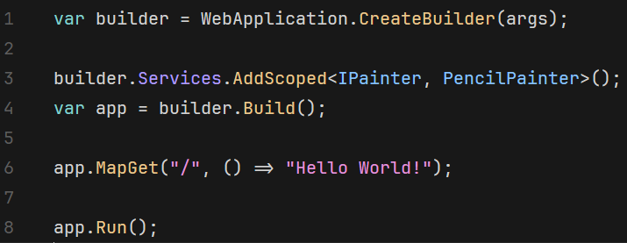
Using IPainter in ASP.NET Core
Notes:
With Dependency Injection

Slide 60
Service Lifetimes
Type | Created | Destroyed
Transient | Created for each request | After the request
Scoped | Once per client connection | After the connection is closed
Singleton | Created for the first request | When the application is ended
Notes:
Reference Page: Dependency injection - .NET | Microsoft Learn
Transient lifetime services are created each time they're requested from the service container. This lifetime works best for lightweight, stateless services. Register transient services with AddTransient.
For web applications, a scoped lifetime indicates that services are created once per client request (connection). Register scoped services with AddScoped.
In apps that process requests, scoped services are disposed at the end of the request.
Singletons are created the first time they are requested and destroyed once the application is killed

Slide 61
ASP.NET Core Middleware
Middleware is software that's assembled into an app pipeline to handle requests and response
Notes:
Request delegates are used to build the request pipeline. The request delegates handle each HTTP request.
Request delegates are configured using Run, Map, and Use extension methods. An individual request delegate can be specified in-line as an anonymous method (called in-line middleware), or it can be defined in a reusable class. These reusable classes and in-line anonymous methods are middleware, also called middleware components. Each middleware component in the request pipeline is responsible for invoking the next component in the pipeline or short-circuiting the pipeline. When a middleware short-circuits, it's called a terminal middleware because it prevents further middleware from processing the request.

Slide 62
Middleware Pipeline

Slide 63

Built In Middleware
Middleware | Description
Authentication | Provides authentication support.
CORS | Configures Cross-Origin Resource Sharing.
Response Caching | Provides support for caching responses.
Response Compression | Provides support for compressing responses.
Routing | Defines and constrains request routes.
Session | Provides support for managing user sessions.
Static Files | Provides support for serving static files and directory browsing.
URL Rewriting Middleware | Provides support for rewriting URLs and redirecting requests.

Slide 64
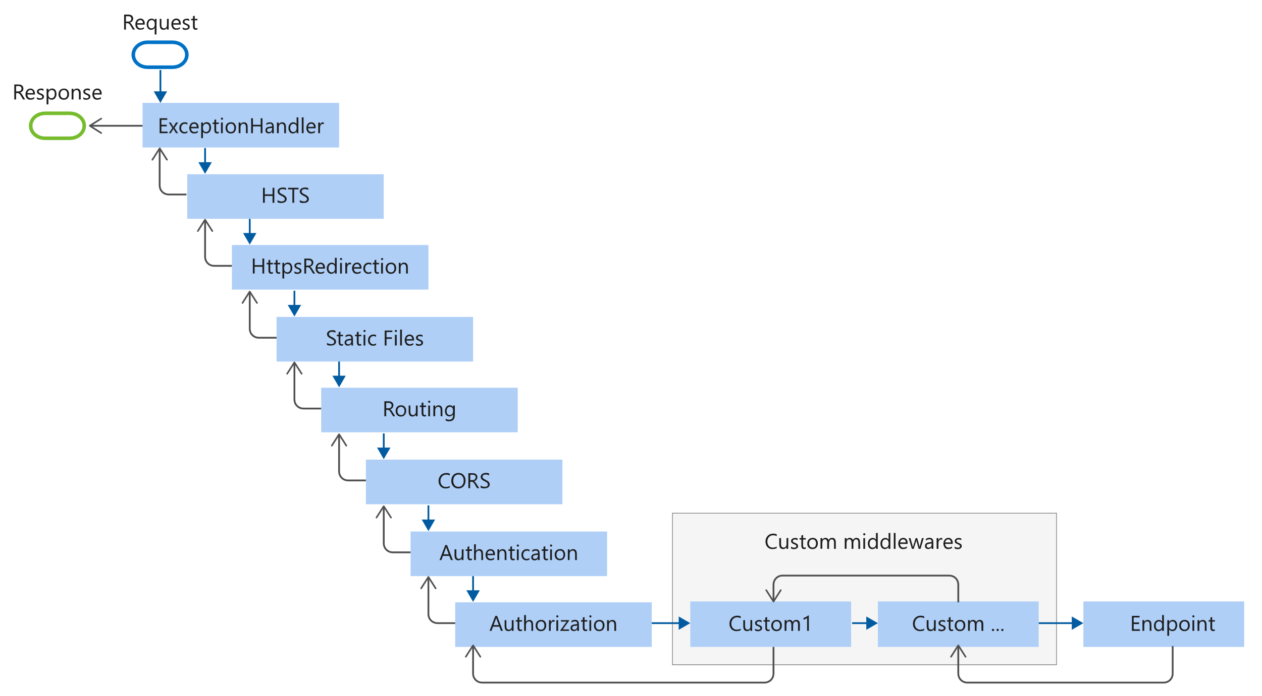
Middleware Pipeline Order

Slide 65
Program.cs – ASP.NET Core Web Application
Middleware
Notes:
No looking at our previous example, we can see we … in use for this application.

Slide 66
ASP.NET Core - Host
The host encapsulates all of the app's resources, such as:
An HTTP server implementation, Middleware components, Logging, Dependency injection (DI) services, Configuration

Slide 67
ASP.NET Core Host Types
WebApplication
WebApplicationBuilder
Sometimes referred to as Minimal Host
Best way to work with the defaults
Provides you the ability to customize the implementation
Notes:
WebApplication behaves similarly to the .NET Generic Host and exposes many of the same interfaces but requires less callbacks to configure.
WebApplicationBuilder allows you to over the defaults upon creation.
Most apps will use the WebApplicationb

Slide 68
ASP.NET Core - Configuration
Application configuration in ASP.NET Core is performed using one or more configuration providers.
Notes:
Reference for this section: Configuration in ASP.NET Core | Microsoft Learn

Slide 69
Configuration Providers
Settings files, such as appsettings.json
Environment variables
Azure Key Vault
Azure App Configuration
Command-line arguments
Custom providers, installed or created
Directory files
In-memory .NET objects
Notes:
Configuration providers read configuration data from key-value pairs using a variety of configuration sources:
ASP.NET Core apps configure and launch a host. The host is responsible for app startup and lifetime management. The ASP.NET Core templates create a WebApplicationBuilder which contains the host. While some configuration can be done in both the host and the application configuration providers, generally, only configuration that is necessary for the host should be done in host configuration.

Slide 70
Default Configuration Provide Priority
Command Line
Non-Prefixed Environment Variables
User Secrets
appSettings.{Environment}.json
appSettings.json
Notes:
Non-prefixed environment variables are environment variables other than those prefixed by ASPNETCORE_ or DOTNET_. For example, the ASP.NET Core web application templates set "ASPNETCORE_ENVIRONMENT": "Development" in launchSettings.json. For more information on ASPNETCORE_ and DOTNET_ environment variables

Slide 71
ASP.NET Core - Environments
ASP.NET Core configures app behavior based on the runtime environment using an environment variable.
Notes:
Reference for this section: Use multiple environments in ASP.NET Core | Microsoft Learn

Slide 72
Environment Variables
DOTNET_ENVIRONMENT
ASPNETCORE_ENVIRONMENT
Notes:
ASPNETCORE_ENVIRONMENT when the WebApplication.CreateBuilder method is called.
The default ASP.NET Core web app templates call WebApplication.CreateBuilder.
The DOTNET_ENVIRONMENT value overrides ASPNETCORE_ENVIRONMENT when WebApplicationBuilder is used.
For other hosts, such as ConfigureWebHostDefaults and WebHost.CreateDefaultBuilder, ASPNETCORE_ENVIRONMENT has higher precedence.

Slide 73
Built in Environment Names
Development
Staging
Production
Notes:
The launchSettings.json sets the environment to Development
The Production is the developer if both DOTNET_ENVIRONMENT and ASPNETCORE_ENVIRONMENT have not been set.

Slide 74
IsDevelopment() Extension Method Sample
Notes:
There are also IsStaging and IsProduction extension methods.

Slide 75
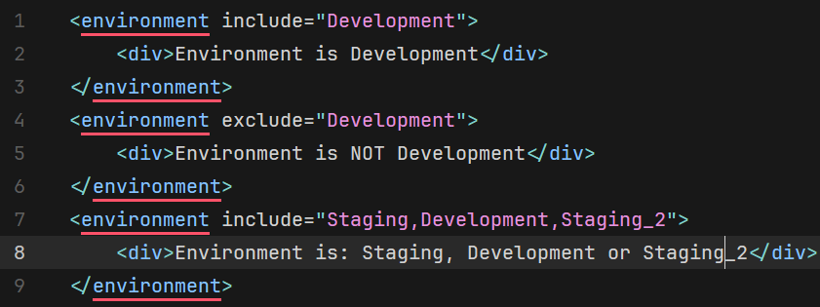
Environment Tag Helper
Notes:
The Environment Tag Helper uses the value of IHostEnvironment.EnvironmentName to include or exclude markup in the element:

Slide 76
ASP.NET Core - Logging
.NET supports a logging API that works with a variety of built-in and third-party logging providers.
Notes:
Reference for this section: Logging in .NET Core and ASP.NET Core | Microsoft Learn

Slide 77
Built-in Logging Providers
Console *
Debug *
EventSource *
EventLog *
TraceSource
Azure App Service
Notes:
The bolded and larger ones are added by default with a call to WebApplication.CreateBuilder

Slide 78
Third-party Logging Providers
Elmah.io
Log4Net
SeriLog
NLog
Stackdriver
others

Slide 79
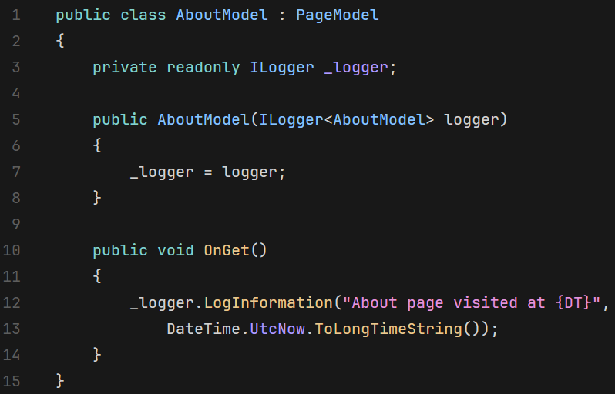
Logging Usage

Slide 80
Logger Levels
LogLevel | Value | Method | Description
Trace | 0 | LogTrace | Contain the most detailed messages. These messages may contain sensitive app data. These messages are disabled by default and should not be enabled in production.
Debug | 1 | LogDebug | For debugging and development. Use with caution in production due to the high volume.
Information | 2 | LogInformation | Tracks the general flow of the app. May have long-term value.
Warning | 3 | LogWarning | For abnormal or unexpected events. Typically includes errors or conditions that don't cause the app to fail.
Error | 4 | LogError | For errors and exceptions that cannot be handled. These messages indicate a failure in the current operation or request, not an app-wide failure.
Critical | 5 | LogCritical | For failures that require immediate attention. Examples: data loss scenarios, out of disk space.
None | 6 |  | Specifies that a logging category shouldn't write messages.
Notes:
Trace = 0
For information that is valuable only to a developer debugging an issue. These messages may contain sensitive application data and so should not be enabled in a production environment. Disabled by default. Example: Credentials: {"User":"someuser", "Password":"P@ssword"}
Debug = 1
For information that has short-term usefulness during development and debugging. Example: Entering method Configure with flag set to true.
Information = 2
For tracking the general flow of the application. These logs typically have some long-term value. Example: Request received for path /api/todo
Warning = 3
For abnormal or unexpected events in the application flow. These may include errors or other conditions that do not cause the application to stop, but which may need to be investigated. Handled exceptions are a common place to use the Warning log level. Example: FileNotFoundException for file quotes.txt.
Error = 4
For errors and exceptions that cannot be handled. These messages indicate a failure in the current activity or operation (such as the current HTTP request), not an application-wide failure. Example log message: Cannot insert record due to duplicate key violation.
Critical = 5
For failures that require immediate attention. Examples: data loss scenarios, out of disk space.

Slide 81
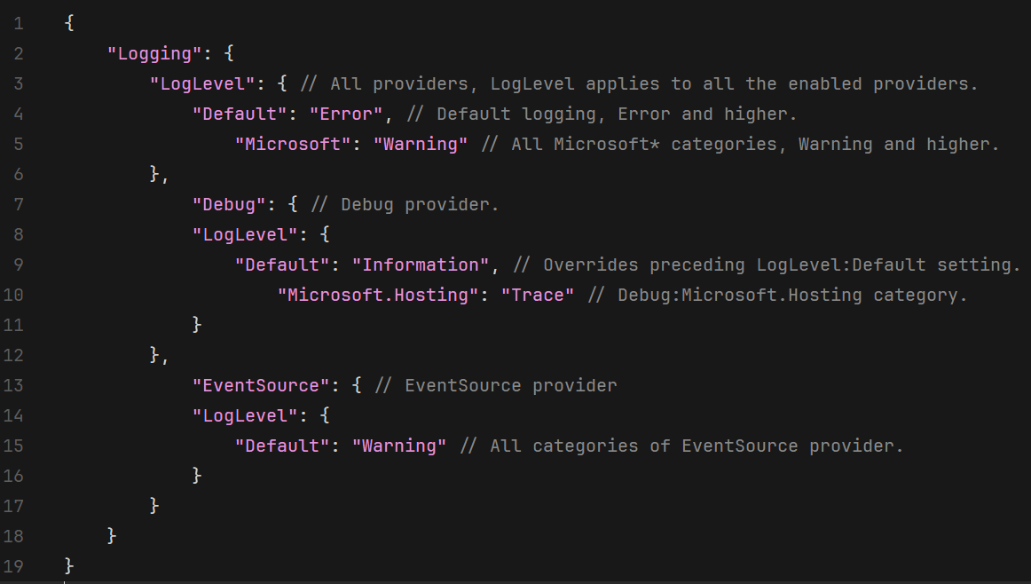
Configure Logging Levels

Slide 82
ASP.NET Core - Logging
.NET supports a logging API that works with a variety of built-in and third-party logging providers.
Notes:
Reference for this section: Logging in .NET Core and ASP.NET Core | Microsoft Learn

Slide 83
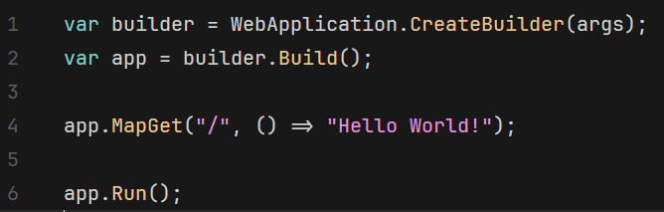
Routing Basics
Notes:
The preceding example includes a single endpoint using the MapGet method:
When an HTTP GET request is sent to the root URL /: (Line 4)
The request delegate executes.
Hello World! is written to the HTTP response.
If the request method is not GET or the root URL is not /, no route matches and an HTTP 404 is returned.
Routing uses a pair of middleware, registered by UseRouting and UseEndpoints:
UseRouting adds route matching to the middleware pipeline. This middleware looks at the set of endpoints defined in the app, and selects the best match based on the request.
UseEndpoints adds endpoint execution to the middleware pipeline. It runs the delegate associated with the selected endpoint.

Slide 84
Routing Endpoints
Notes:
The string /hello/{name:alpha} is a route template. A route template is used to configure how the endpoint is matched. In this case, the template matches:
A URL like /hello/Docs
Any URL path that begins with /hello/ followed by a sequence of alphabetic characters. :alpha applies a route constraint that matches only alphabetic characters. Route constraints are explained later in this article.
The second segment of the URL path, {name:alpha}:
Is bound to the name parameter.
Is captured and stored in HttpRequest.RouteValues.

Slide 85
Route Template
{controller=Home}/{action=Index}
Home/View
files/{filename}.{ext?}
/files/myfile.txt
Contacts/View
/files/myfile
Notes:
Reference: Routing in ASP.NET Core | Microsoft Learn
Tokens within {} define route parameters that are bound if the route is matched. More than one route parameter can be defined in a route segment, but route parameters must be separated by a literal value. For example:

Slide 86
Route Template Examples
 | Route Template | Example Matching URI | The request URI…
1 | hello | /hello | Only matches the single path /hello.
2 | {Page=Home} | / | Matches and sets Page to Home.
3 | {Page=Home} | /Contact | Matches and sets Page to Contact.
4 | {controller}/{action}/{id?} | /Products/List | Maps to the Products controller and List action.
5 | {controller}/{action}/{id?} | /Products/Details/123 | Maps to the Products controller and Details action withid set to 123.
6 | {controller=Home}/{action=Index}/{id?} | / | Maps to the Home controller and Index method. id is ignored.
7 | {controller=Home}/{action=Index}/{id?} | /Products | Maps to the Products controller and Index method. id is ignored.

Slide 87
Routing Constraints
int
bool
decimal
datetime
double
float
guid
long
minlength(value)
maxlength(value)
length(length)
length(mix, max)
min(value)
max(value)
range(min, max)
alpha
regex
required
Notes:
https://learn.microsoft.com/en-us/aspnet/core/fundamentals/routing?view=aspnetcore-7.0#route-constraints

Slide 88
ASP.NET Core - Exceptions
Common approaches to handling exceptions in ASP.NET Core
Notes:
Reference for this section: Handle errors in ASP.NET Core | Microsoft Learn

Slide 89
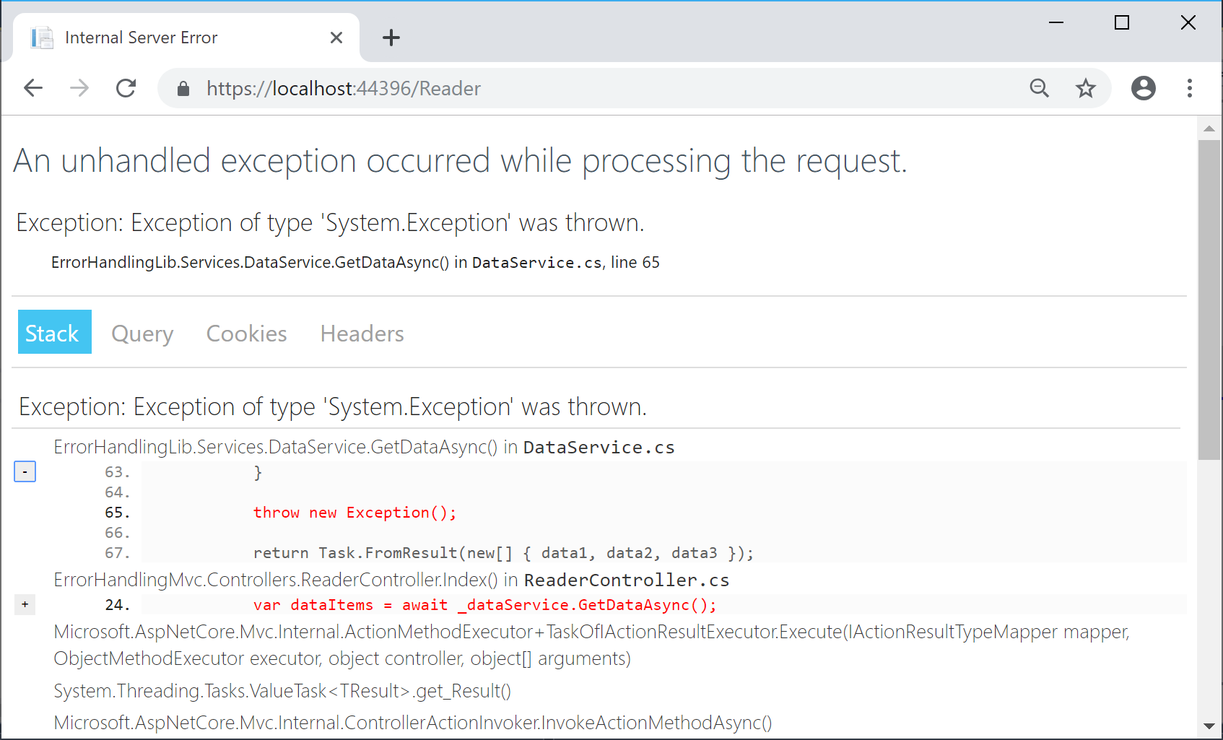
Exception Handler Page
Notes:
Only created when you have the app.UseExceptionHandler("/Error"); set

Slide 90
UseExceptionHandler(“/Error”)

Slide 91
Web Applications in .NET 6
ASP.NET Core is a complete UI framework.
Notes:
Reference: Choose an ASP.NET Core UI | Microsoft Learn

Slide 92
ASP.NET Core – UI Options
Server Rendered UI
Client Rendered UI
ASP.NET Core Razor Pages
ASP.NET Core MVC
Blazor Server
Blazor WebAssembly
ASP.NET Core Single Page Application (SPA)
Notes:
Razor Pages is a page-based model. UI and business logic concerns are kept separate, but within the page. Razor Pages is the recommended way to create new page-based or form-based apps for developers new to ASP.NET Core. Razor Pages provides an easier starting point than ASP.NET Core MVC.
ASP.NET MVC renders UI on the server and uses a Model-View-Controller (MVC) architectural pattern. The MVC pattern separates an app into three main groups of components: Models, Views, and Controllers. More on that in a minute
Blazor is a framework for building interactive client-side web UI with .NET:
Blazor WebAssembly is a single-page app (SPA) framework for building interactive client-side web apps with the general characteristics described in the Blazor Server section earlier in this article.
Build client-side logic for ASP.NET Core apps using popular JavaScript frameworks, like Angular or React

Slide 93
Model View Controller (MVC)
User
Uses
Controller
Changes
Models
Updates
View
Sees
Notes:
The Model-View-Controller (MVC) architectural pattern separates an application into three main groups of components: Models, Views, and Controllers. This pattern helps to achieve separation of concerns. Using this pattern, user requests are routed to a Controller which is responsible for working with the Model to perform user actions and/or retrieve results of queries. The Controller chooses the View to display to the user, and provides it with any Model data it requires.

Slide 94
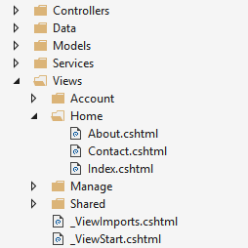



Views
Views by Controller
Notes:
In ASP.NET Core MVC, views are .cshtml files that use the C# programming language in Razor markup. Usually, view files are grouped into folders named for each of the app's controllers.

Slide 95

Demo Time
Finally!
Notes:
Show Demo aspnetcore-webapp.md

Slide 96
Web APIs in .NET 6
ASP.NET Core supports creating web APIs using controllers or using minimal APIs.
Notes:
Reference: APIs overview | Microsoft Learn

Slide 97
Web APIs – Minimal APIs
Minimal APIs are a simplified approach for building fast HTTP APIs with ASP.NET Core.
Notes:
Reference: Minimal APIs overview | Microsoft Learn
Minimal APIs are a simplified approach for building fast HTTP APIs with ASP.NET Core. You can build fully functioning REST endpoints with minimal code and configuration. Skip traditional scaffolding and avoid unnecessary controllers by fluently declaring API routes and actions.

Slide 98
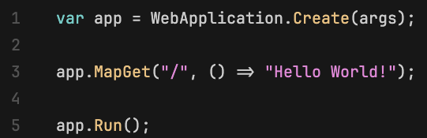
Minimalist API

Slide 99
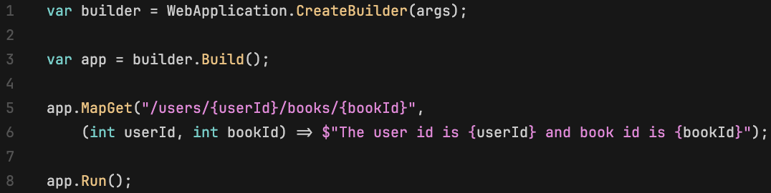
Minimal APIs with More!
Notes:
Explain the code
Minimal simply means that it contains the minimum set of components needed to build HTTP APIs, such as routing, model/parameter binding and serialization. It doesn’t mean that the application you build will be simple or not require good design.

Slide 100
Web APIs - Controllers
ASP.NET Core supports creating web APIs using controllers or using minimal APIs.
Notes:
Reference: Create web APIs with ASP.NET Core | Microsoft Learn
Controllers in a web API are classes that derive from ControllerBase. Controllers are activated and disposed on a per request basis.

Slide 101
Demo Time
New ASP.NET Core Web API

Slide 102
CRUD & Web Verbs
Create
Post
Read
Get
Update
Put
Delete
Delete

Slide 103
TODO API
API | Description | Request body | Response body
GET /api/todoitems | Get all to-do items | None | Array of to-do items
GET /api/todoitems/{id} | Get an item by ID | None | To-do item
POST /api/todoitems | Add a new item | To-do item | To-do item
PUT /api/todoitems/{id} | Update an existing item | To-do item | None
DELETE /api/todoitems/{id} | Delete an item | None | None

Slide 104
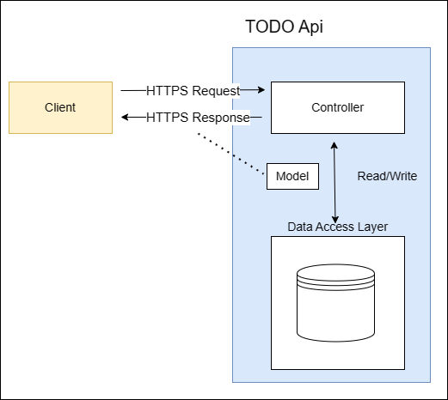
TODO API Flow

Slide 105
Demo Time
TODO API
Notes:
Show Demo aspnetcore-todoapi.md

Slide 106
Web APIs – Swagger/OpenAPI
Swagger (OpenAPI) is a language-agnostic specification for describing REST APIs. It allows both computers and humans to understand the capabilities of a REST API without direct access to the source code.
Notes:
Reference: ASP.NET Core web API documentation with Swagger / OpenAPI | Microsoft Learn
The Swagger project was donated to the OpenAPI Initiative in 2015 and has since been referred to as OpenAPI. Both names are used interchangeably. However, "OpenAPI" refers to the specification. "Swagger" refers to the family of open-source and commercial products from SmartBear that work with the OpenAPI Specification. Subsequent open-source products, such as OpenAPIGenerator, also fall under the Swagger family name, despite not being released by SmartBear.
In short:
OpenAPI is a specification.
Swagger is tooling that uses the OpenAPI specification. For example, OpenAPIGenerator and SwaggerUI.

Slide 107
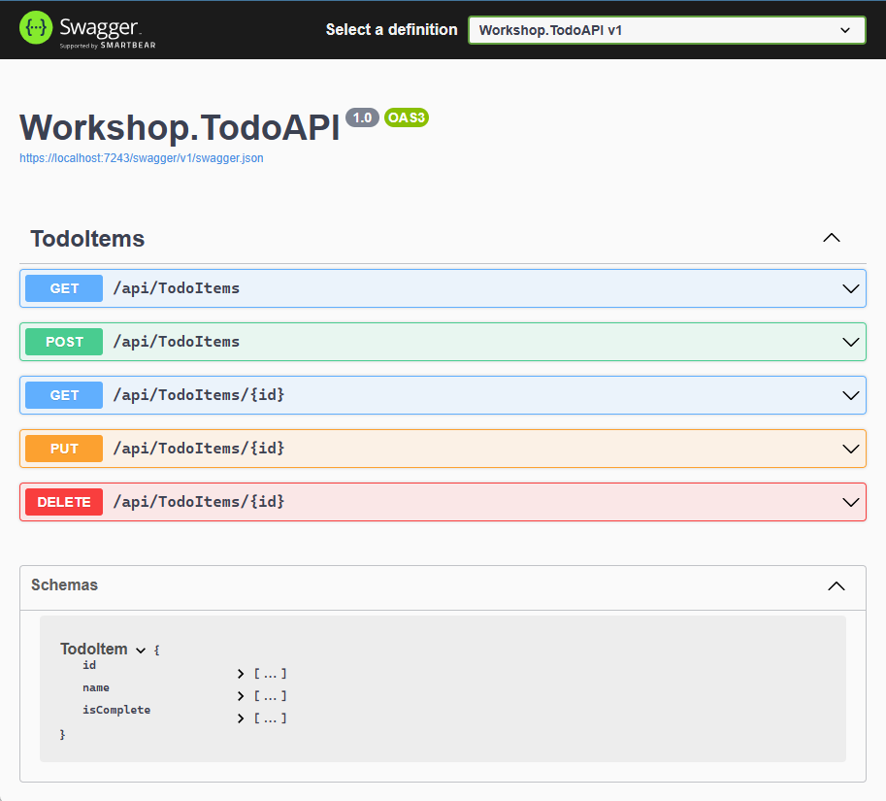
Swagger UI

Slide 108
Documenting the Code
Swashbuckle
NSwag
Swashbuckle.AspNetCore.Swagger
NSwag.AspNetCore
Notes:
Swashbuckle is automatically included in the project if you select OpenAPI when creating the

Slide 109
Demo Time
Let’s Document the TODO API
Notes:
Show Demo aspnetcore-todoapi-document.md
# A

Slide 110
Hands On Lab
Educator voila1234

Slide 111
The Application
Web
Data
API
Logic
Logic Tests
Contacts
Domain

Slide 112
Our Domain
Contacts
Phones
PhoneTypes
AddressTypes
Addresses
The classes for this application and their relationships

Slide 113
Database Tables
Address
Contacts
PK
AddressId
Phones
PK
ContactId
StreetAddress
PK
PhoneId
FirstName
SecondaryAddress
PhoneNumber
MiddleName
Unit
Extension
LastName
City
PhoneTypeId
EmailAddress
State
ContactId
ImageUrl
Country
Birthday
PostalCode
Anniversary
AddressTypeId
ContactId
PhoneTypes
AddressTypes
PK
PhoneTypeId
PK
AddressTypeId
Type
Type
Description
Description

Slide 114
Workshop
https://jjg.me/mscc-workshop
https://jjg.me/mscc-workshop-instructions
Notes:
Open mscc-workshop/src/start/src/workshop-instructions.md at main · jguadagno/mscc-workshop · GitHub
Open jguadagno/mscc-workshop (github.com)

Slide 115
Debugging Tips & Tricks

Slide 116
Debugging Tips & Tricks
Lots of Debugging
No More Slides

Slide 117
References
Site | Url
My Site | https://jjg.me/mysite
My GitHub | https://jjg.me/github
Upgrade Assistant | https://jjg.me/6_upgrade_assistant

Slide 118

Q & A

Slide 119
About Joe Guadagno
@jguadagno
JosephGuadagnoNet
JosephGuadagno
Jjg.me/aboutjjg
Jjg.me/github
Jjg.me/youtube
jguadagno@hotmail.com

